Slide 1
Computer Architecture: The Instruction Set Architecture (ISA) Part 1: Generics
Dr. Colin O’Flynn

Slide 2
Lectures
How does a program run on a machine?
How do you compile from high-level code to machine code?
How do you observe the machine running?
How do we define the machine?

Slide 3
Defining a Processor
We will only need a few simple components:
Memories – to store our program (instructions) and data
A register file – instructions will read their operands from the register file and also write their results to it.
Registers, an ALU and adders
Decode and control logic
Notes:
These components should be familiar from an introductory course on digital electronics.
Memories - To keep things simple, we will use a different memory for instructions and data in this example. This is also the norm for real processors as we often want to access both instructions and data in memory at the same time.
The register file is simply a small multi-ported memory. Adding multiple “ports” allows us to read from, or write to, multiple memory locations in a single clock cycle.
Our register file has two read ports and a single write port - we can read two values and write a result in a single clock cycle.
Our processor can only load data from memory into our register file and store data from the register file to memory using special load and store instructions. Architectures that restrict memory access to a few instructions like this are called load-store architectures
ALU – Arithmetic Logic Unit, a functional unit capable of performing a range of arithmetic and logical operations. The input is typically two operands and the operation to be performed (e.g., add, shift, xor, etc.). The output is the result.

Slide 4
A Simple (32-bit) Processor
Let’s assume all our instructions are encoded in 32-bits/
Our registers and datapath are also 32-bits wide.
Memory is accessed with a 32-bit address and returns 32-bit data.
Our processor has 32 registers, hence we must use 5-bits to identify a particular register (as 2^5 =32).

Slide 5
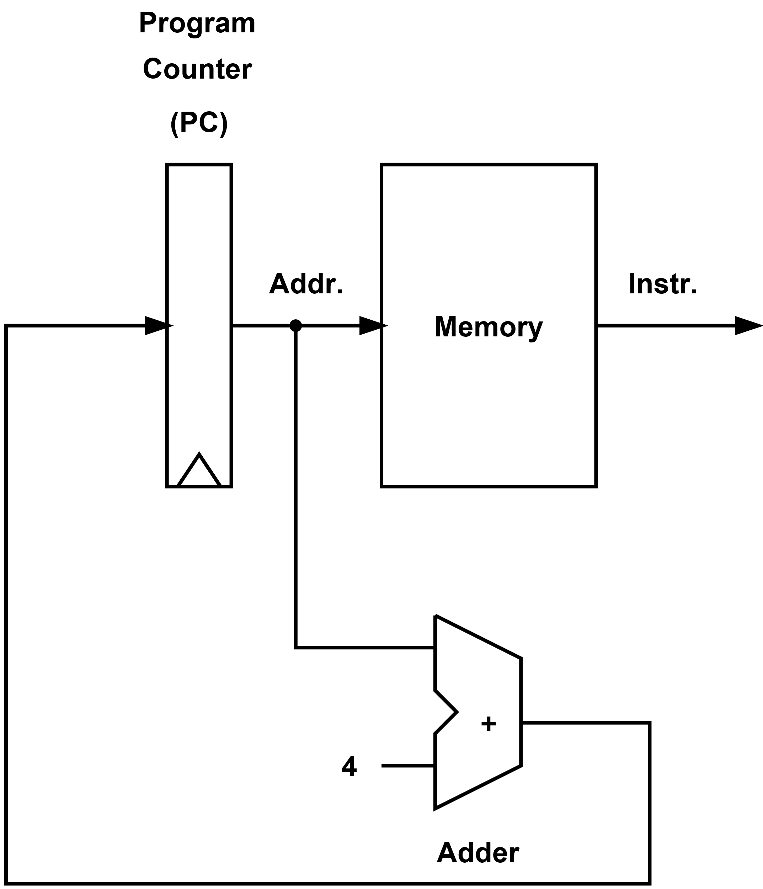
A Processor Datapath – PC and Instruction Memory
Our Program Counter (PC) stores the address of the instruction currently being fetched from memory.
This simple datapath increases the PC by 4 (bytes) on each cycle and only allows us to read each 32-bit instruction in turn.
We need to add more logic to actually compute, handle branches, provide registers, access data memory, etc.
Notes:
A datapath is simply a collection of registers, ALUs, memories, etc. that operate on words of data. Processors are constructed from datapaths and control logic. The control logic provides the select, enable, and other control signals to each of the datapath components necessary to execute each instruction correctly.

Slide 6
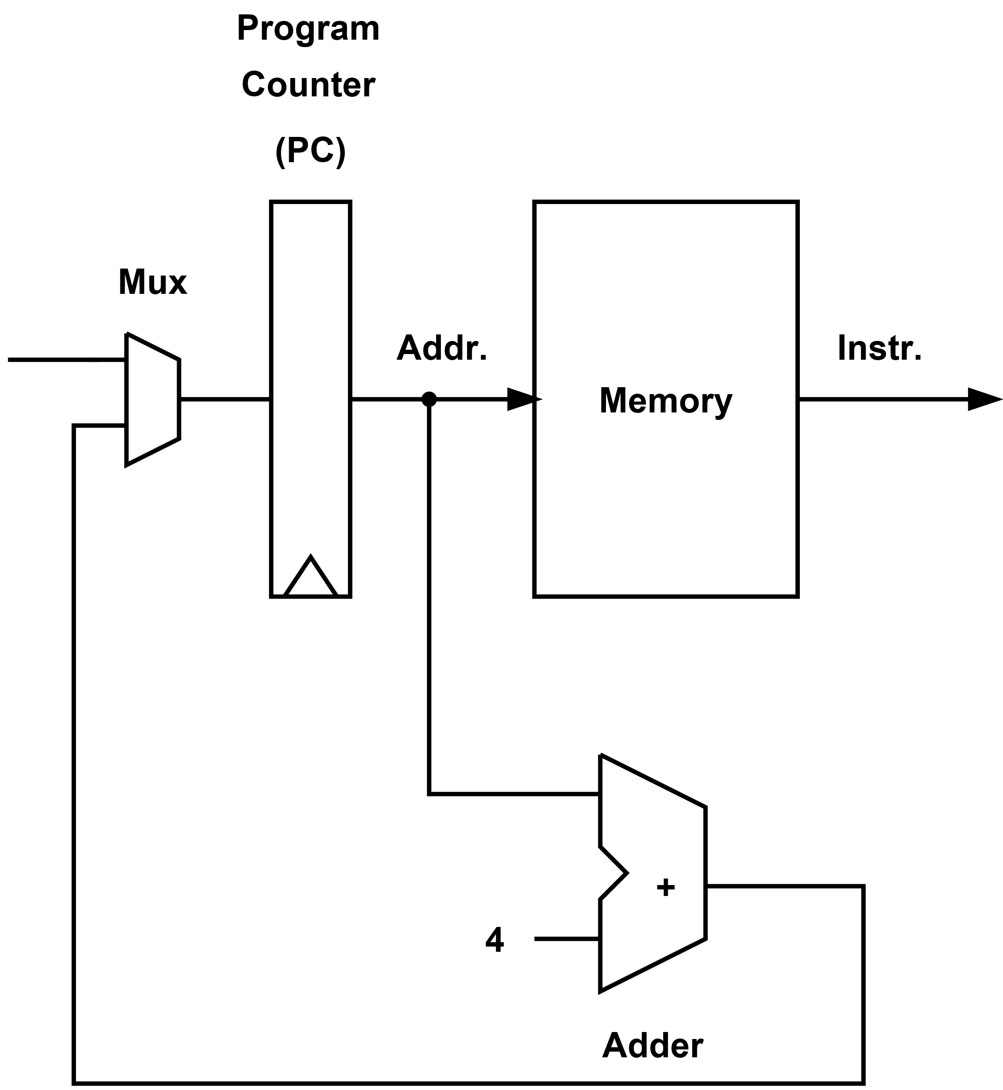
A Processor Datapath – Add mux to Allow Jump/Branch
We add a multiplexor (mux) to allow us to provide a branch target address, i.e., the PC value following a taken branch.

Slide 7
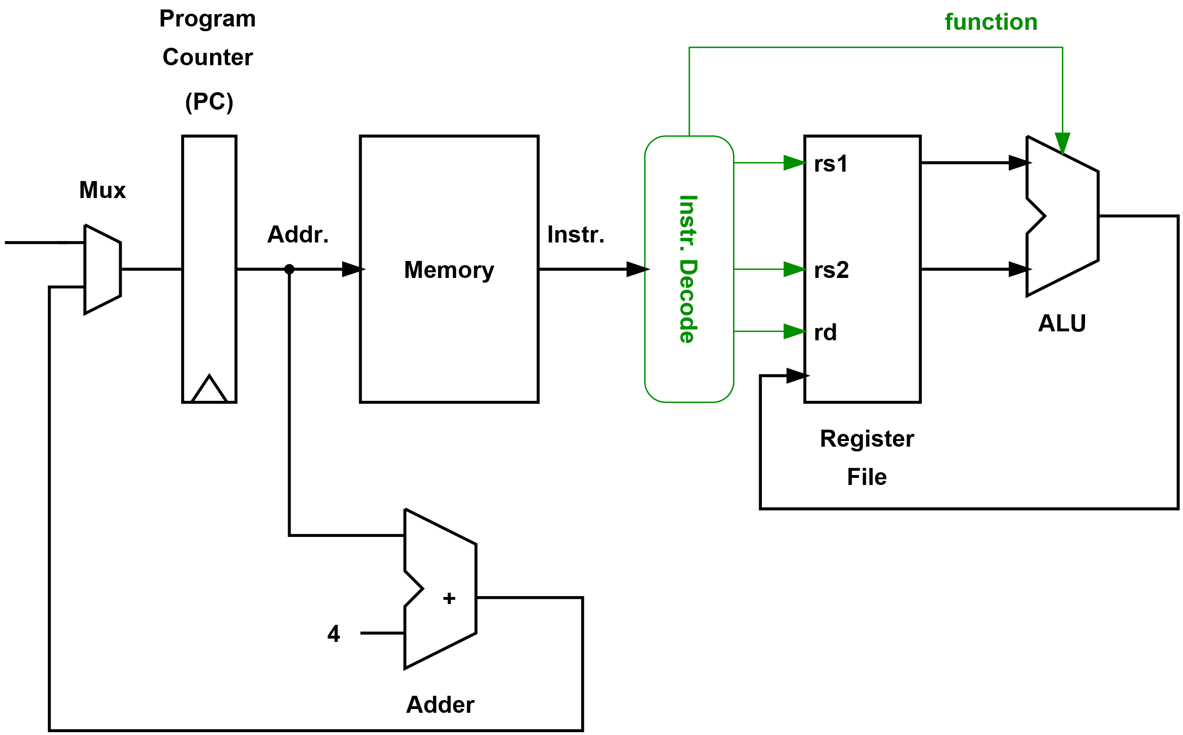
A Processor Datapath – Add a Register File and ALU
We could now execute a simple sequence of ALU operations.
Although, we do not yet have access to data memory and can’t branch!
We also add decode logic that extracts information from our instruction; in this case, the source registers (rs1, rs2), destination register (rd), and the ALU function to be performed.

Slide 8
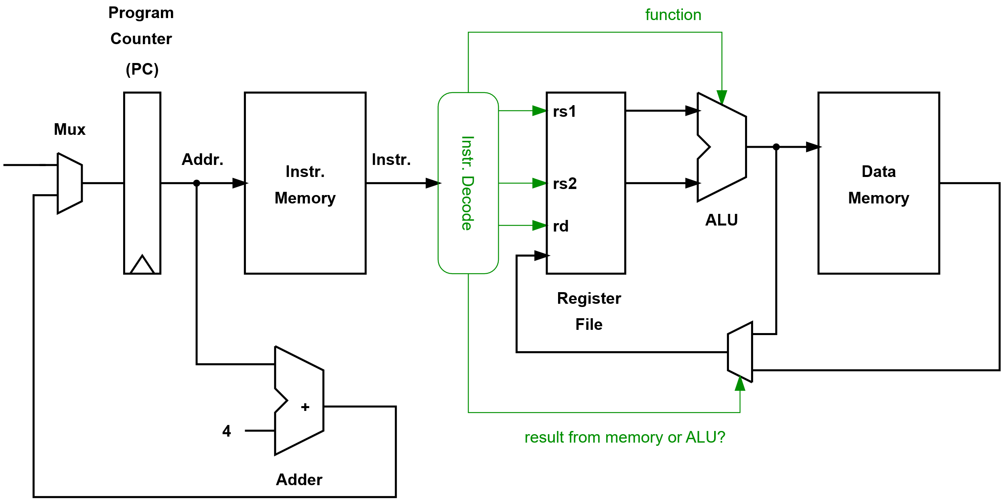
A Processor Datapath – Loading from Data Memory
We extend the datapath so we can implement an instruction that loads from data memory.
The effective address could be the sum of the two source registers.

Slide 9
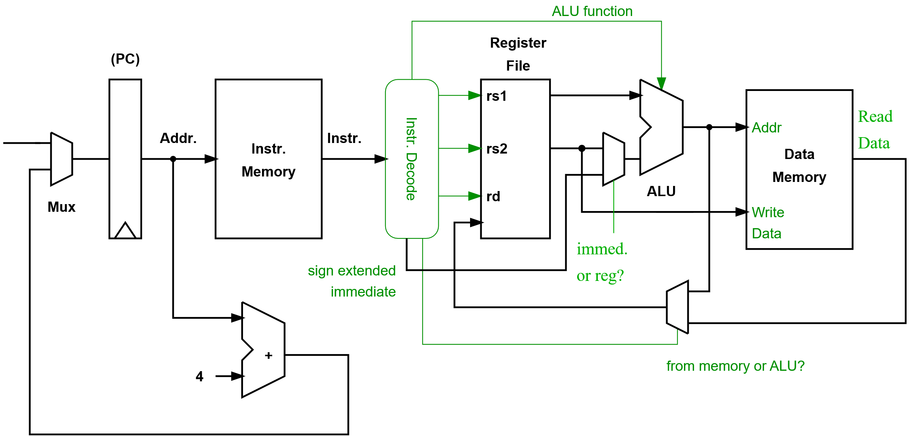
A Processor Datapath – Storing to Data Memory
Storing to memory requires we provide both an address and the data to write.
We have also added the ability to extract immediate values from the instructions and use them in ALU operations or address calculations.
Notes:
Sign extending immediate values
Our immediate values are contained within instructions so will be less than 32-bits (our instructions are a fixed size, and we will need to use some bits to indicate what the instruction is and at least specify a destination register). Before we use these values within our datapath, we must increase their width to 32-bits. This must be done while preserving the number’s sign and value. As the value is stored in two’s complement form, we simply duplicate the most significant bit (MSB) to fill the additional uppermost bits.

Slide 10
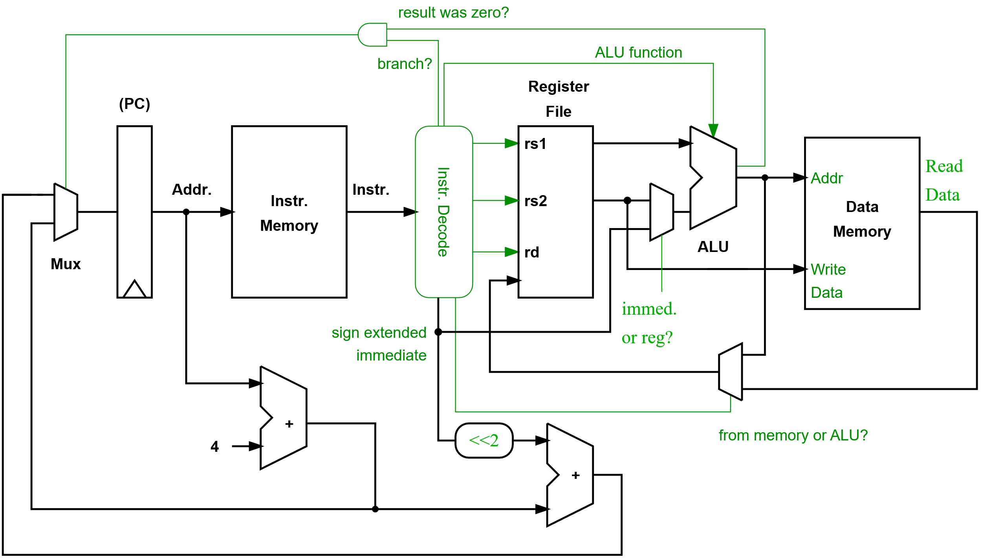
A Processor Datapath – Supporting Branch Instructions
Here, we assume a simple “branch if equal to zero” instruction.
Our branch target address is computed relative to the PC. Our immediate (the offset) is shifted left by two (i.e., multiplied by 4) as all instructions are 32-bits.
Notes:
In our simple processor, all instructions are 32-bits, hence all branch targets will be aligned on 32-bit boundaries. Therefore, the lower two bits of the address are always zero. Hence, we don’t need to store these lower bits in the instruction and can simply shift the immediate value two places to the left when adding to the current PC value (i.e., specify the PC offset in terms of the number of instructions and then multiply by 4 to get the offset in terms of bytes).
------
Other resources:
Here is a link to a visual simulation of the Arm1 processor. It is possible to zoom in (using the mouse wheel) and watch the processor in action. Individual transistors and the interconnect between them is clearly visible.
http://visual6502.org/sim/varm/armgl.html
http://www.righto.com/2015/12/reverse-engineering-arm1-ancestor-of.htmls
The Arm1 was introduced in 1985 using a 3 micron technology (today’s cutting edge technologies are called “10 nm or 7 nm”).
The Arm1’s peak performance was 8 MIPS.
The processor was organized as a three stage pipeline:
Instruction fetch
Instruction decode
Execute: Register read, shift, ALU, register write (and memory accesses)
Some instructions could take up to 5 cycles to complete as they need to be run through the execute stage two or three times given the processors limited resources.

Slide 11
Encoding our Instructions
A simple data processing instruction may have the following format, where Operand2 may be a register or immediate value.
Given 32-bits to encode our instructions, we may invent two simple instruction encoding formats for our processor, e.g.:
Instruction Rd, Rs, Operand2
31
25
20
15
10
0
op | rs1 | rs2 | rd | function
op | rs1 | rs2 / rd | immediate
15

Slide 12
What the ISA?
ISA Specifies:
Instruction encodings
Registers
Data types
Addressing modes
Memory models
Privilege levels
Exception behaviors

Slide 13
What the ISA?
ISA DOES NOT Specify:
Clock speeds
Pipeline depth
Cache sizes
Power consumption
… etc
ISA does not specify HOW it works

Slide 14
ISA Code Compatibility
In general we look for code compatibility across the ISA.
Code that works on one processor in the ISA should work on others.
There may be certain features that can be enabled or disabled (will come back to this)

Slide 15
CISC vs. RISC
Complex Instruction Set Computer (CISC)
Do very complex tasks
Most instructions (arithmetic) can access memory
Variable-length instruction encoding (e.g., for x86 from 8 to 120 bits)
x86 is a common example
Reduced Instruction Set Computer (RISC)
Do simple tasks – but do them quickly
Only special load/store instructions can access memory
Fixed-length instruction encoding (or a small number of choices, e.g., 32 or 16 bits)
Arm is a common example

Slide 16
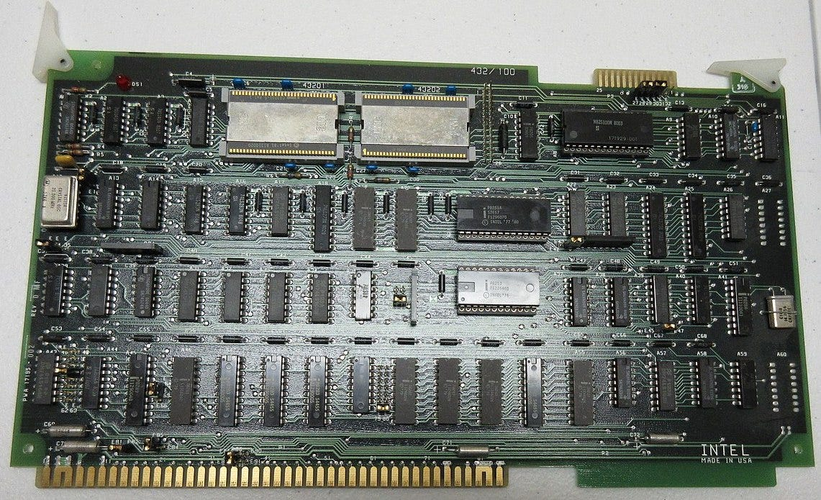
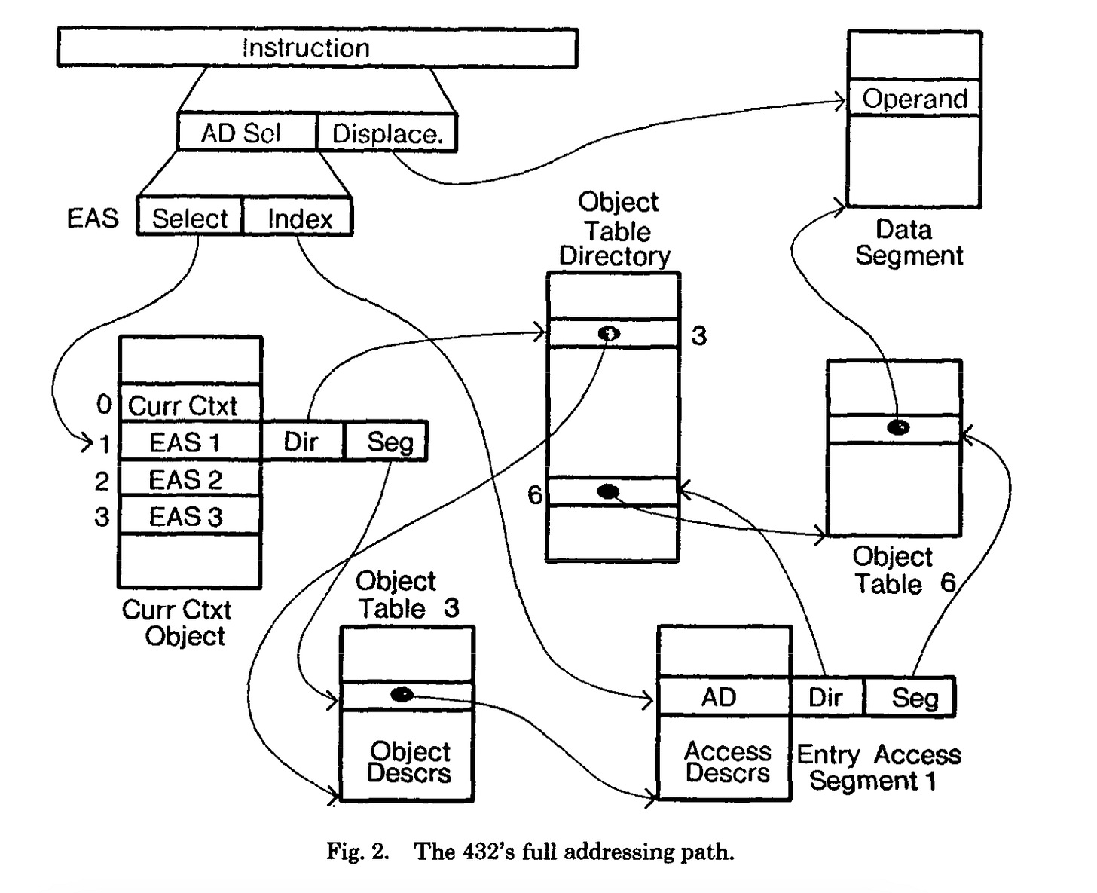
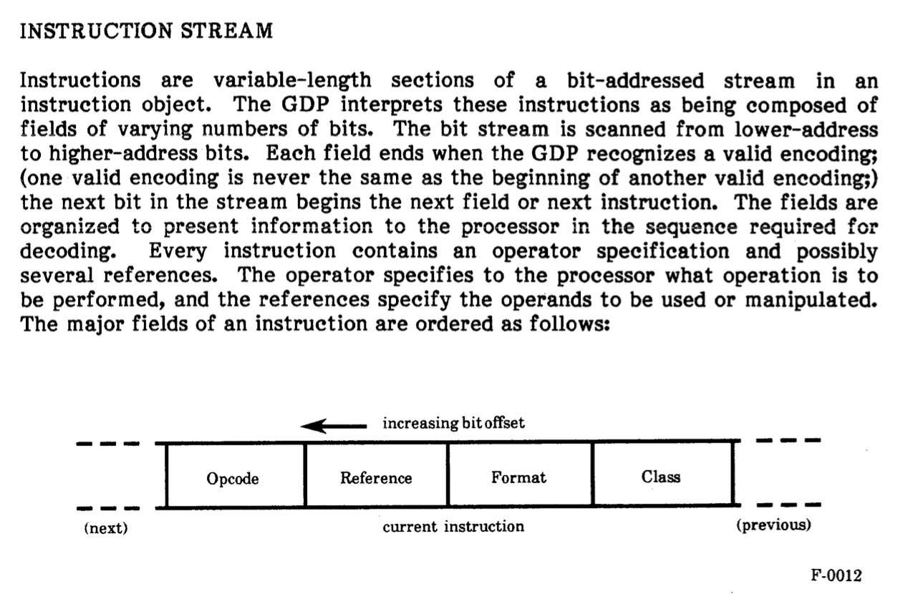
Sidenote: “Super-CISC” Architectures
iAPX432 Board brouhaha_, CC BY-SA 2.0
https://thechipletter.substack.com/p/iapx432-gordon-moore-risk-and-intels

Slide 17
Registers & Memory

Slide 18
Register-Memory Architecture
One of the operations of ALU instructions may be in memory
Normal in CISC ISA, e.g., x86:
Instruction | Description | Pseudocode
ADD eax, [memory_var] | Adds the 32-bit value stored at the memory address memory_var to the EAX register. The result is stored in EAX. | EAX = EAX + *(int*)memory_var
IMUL eax, [ebx + 4] | Fetches a 32-bit value from memory at the address ebx + 4 and multiplies it by the value in eax, storing the result back in eax. | EAX = *(int*)(EBX+4) x EAX

Slide 19
Load-Store Architecture
Also called register-register architecture
Normal in RISC ISA
Special load/store instructions are the only way to access memory
E.g., Arm:
Instruction | Description | Pseudocode
ldr r1, [r0] | Load the value from the address in R0 into R1 | R1 = *((int*)R1)

Slide 20
Registers and the ISA in ARM
31
28
8
4
0
r0
N
Z
C
V
I F T
Mode
r1
r2
r3
r4
Copies of the ALU status flags (latched if the
instruction has the "S" bit set).
r5
r6
r7
r8
Interrupt Disable bits.
I = 1, disables the IRQ.
F = 1, disables the FIQ.
T Bit (Architecture v4T only)
T = 0, Processor in ARM state
T = 1, Processor in Thumb state
r9
r10
N = Negative result from ALU flag.
Z = Zero result from ALU flag.
C = ALU operation Carried out
V = ALU operation oVerflowed
r11
r12
r13 (sp)
r14 (lr)
r15 (pc)
Program Status Registers
Mode Bits
M[4:0] define the processor mode.
cpsr

Slide 21
Privilege Levels & Operating Modes
Most ISA have an idea of user execution and privileged execution
Controls:
Access to registers
Access to memory
Possibly some instructions

Slide 22
Registers in Operating Modes
General registers and Program Counter
User32 / System
FIQ32
Supervisor32
Abort32
IRQ32
Undefined32
r0
r0
r0
r0
r0
r0
r1
r1
r1
r1
r1
r1
r2
r2
r2
r2
r2
r2
r3
r3
r3
r3
r3
r3
r4
r4
r4
r4
r4
r4
r5
r5
r5
r5
r5
r5
r6
r6
r6
r6
r6
r6
r7
r7
r7
r7
r7
r7
r8
r8_fiq
r8
r8
r8
r8
r9
r9_fiq
r9
r9
r9
r9
r10
r10_fiq
r10
r10
r10
r10
r11
r11_fiq
r11
r11
r11
r11
r12
r12_fiq
r12
r12
r12
r12
r13 (sp)
r13_fiq
r13_svc
r13_abt
r13_irq
r13_undef
r14 (lr)
r14_fiq
r14_svc
r14_abt
r14_irq
r14_undef
r15 (pc)
r15 (pc)
r15 (pc)
r15 (pc)
r15 (pc)
r15 (pc)
Program Status Registers
cpsr
cpsr
cpsr
cpsr
cpsr
cpsr
sprsr_fiq
sprsr_fiq
sprsr_fiq
sprsr_fiq
sprsr_fiq
spsr_fiq
spsr_svc
spsr_abt
sprsr_fiq
sprsr_fiq
sprsr_fiq
sprsr_fiq
sprsr_fiq
spsr_irq
spsr_undef
sprsr_fiq
sprsr_fiq
sprsr_fiq
sprsr_fiq
sprsr_fiq

Slide 23
e.g., User to Fast Interrupt (FIQ)
Registers in use
Registers in use
User Mode
FIQ Mode
r0
r0
r1
r1
r2
r2
r3
r3
r4
r4
r5
r5
r6
r6
r7
EXCEPTION
r7
r8
r8_fiq
r8
r8_fiq
r9
r9_fiq
r9
r9_fiq
r10
r10_fiq
r10
r10_fiq
r11
r11_fiq
r11
r11_fiq
r12
r12_fiq
r12
r12_fiq
r13 (sp)
r13_fiq
r13 (sp)
r13_fiq
r14 (lr)
r14_fiq
r14 (lr)
r14_fiq
r15 (pc)
Return address calculated from User mode PC value and stored in FIQ mode LR
r15 (pc)
cpsr
cpsr
spsr_fiq
spsr_fiq
User mode CPSR copied to FIQ mode SPSR

Slide 24
Addressing Modes
Register
Register + offset
Immediate
PC-relative

Slide 25
Addressing: Register
Operands in register, e.g.:
ADD r0, r1, r2 → r0 = r1 + r2

Slide 26
Addressing: Register + Offset (Base + Offset)
Base register + immediate offset
LDR r0, [r1, #8] → r0 = *(uint32_t *)(r1 + 8)
Consider:
C struct fields
Stack pointer or frame

Slide 27
Addressing: Stack-Based Access
Base register + offset:
LDR r0, [sp, #12] → r0 = *(uint32_t *)(sp + 12)
Remember that “sp” is another register – this makes our usage of the stack very easy (or the compiler’s usage)

Slide 28
Addressing: Register Offset Addressing
Base register + offset stored in another register
LDR r0, [r1, r2] → r0 = *(uint32_t *)(r1 + r2)
Array indexing & pointer arithmetic:
arr[i]

Slide 29
Addressing: Scaled Register Offset
Offset scaled by element size
LDR r0, [r1, r2, LSL #2] → r0 = *(uint32_t *)(r1 + r2 * 4)
Makes for efficient table & array indexing!
LSL = Logical Shift Left:
LSL #1 = a << 1 = a × 2
LSL #2 = a << 2 = a × 4
LSL #3 = a << 3 = a × 8

Slide 30
Addressing: Immediate
Operand is encoded directly in the instruction, e.g.:
ADD r0, r1, #5 → r0 = r1 + 5
Constraint: Operand size is limited, or you have weird encodings (we will see this later when we go through Arm instruction set)
Why? Remember we want fixed instruction lengths.

Slide 31
Addressing: Immediate (Cont’d)
e.g., using Immediate Addressing to load a larger constant:
MOVW r0, #0x1234 ; Move Wide (lower 16 bits)
MOVT r0, #0x5678 ; Move Top (upper 16 bits)
…ARM uses a more complex encoding even that means these won’t work as-is necessarily, more on that later…

Slide 32
Addressing: PC-Relative
Address = PC + Offset:
LDR r0, [pc, #24] → r0 = *(uint32_t *)(pc + 24)
Load relative to the current code location. This is a powerful tool as it means if you move the code & constants together, the addresses are all still accurate.
This is used for loading constants in flash normally, which get placed near the code they are used in.

Slide 33
Addressing: PC-Relative Branches
Not data, but we have the same thing for the “branch” (control flow) instruction:
B #64 → pc = pc + 64
Relative means code can be relocated without recalculating branches.

Slide 34
Addressing: Pre-Indexed Addressing
Address is updated before access. E.g.:
LDR r0, [r1, #4]!
Is decoded to:
r1 = r1 + 4
r0 = *(r1)
Very handy for pointer incrementing!

Slide 35
Addressing: Post-Indexed Addressing
Address is updated after access. E.g.:
LDR r0, [r1], #4
Is decoded to:
r0 = *(r1)
r1 = r1 + 4
Very handy for copy loops!

Slide 36
Memory Model
Addressing mode: how an address is computed
Memory model: how memory operations are ordered in execution
Sequentially Consistent
Everything happens in program order
Slower (can get caught on one slow execution)
Relaxed Model
Reordering allowed
Higher performance

Slide 37
Arm Memory Model
ARM is explicitly relaxed (most modern ISAs are relaxed)
Special care taken when order matters:
“Barriers” are an instruction that tells arm to ensure memory operations complete before continuing execution
Atomic operations guarantee a complete write or read happens

Slide 38
Odd ISA Instructions?
ISAs try to encode common patterns, not just arbitrary math.
You may run across “weird” instructions, like:
Bit-field operations (set & clear bits)
Multiply-accumulate
Special barrier instructions
These are normally designed to optimize common embedded use-cases, like:
Setting/clearing bits in registers
Enabling efficient compiler patterns
For specific power or timing reasons

Slide 39
The ARM ISA Family
(A)pplication
(R)eal-Time
(M)icrocontroller
Arm Cortex-A = Application Level (Cell Phone)
Arm Cortex-M = Microcontroller (what we’ll look at)
Arm Cortex-R = Real-time specific (similar to microcontroller)

Slide 40
Sidenote on ARM Meaning
ARM = Advanced RISC Machine

Slide 41
ISA Code Compatibility – e.g., Arm ISA
Feature | M0 / M0+ | M3 | M4 | M7 | M23 | M33
Thumb (16-bit) | Yes | Yes | Yes | Yes | Yes | Yes
Thumb-2 (32-bit) | No | Yes | Yes | Yes | No | Yes
MOVW / MOVT | No | Yes | Yes | Yes | No | Yes
ISA version | ARMv6-M | ARMv7-M | ARMv7E-M | ARMv7E-M | ARMv8-M | ARMv8-M

Slide 42
ISA Code Compatibility – e.g., Arm Optional
Feature | M0 / M0+ | M3 | M4 | M7 | M23 | M33
DSP instructions | No | No | Yes | Yes | No | Optional
Hardware divide | No | Optional | Optional | Optional | No | Optional
Single-precision FPU | No | No | Optional | Optional | No | Optional
Double-precision FPU | No | No | No | Optional | No | No
TrustZone-M | No | No | No | No | Yes | Yes

Slide 43
Summary
Instruction Set Architecture defines the machine:
Memory model
Addressing
Registers
Instructions
There are different design choices, most break down to:
Register-Memory (CISC)
Register-Register / Load-Store (RISC)
Reviewed common addressing modes
Reviewed examples of code compatibility on Cortex-M specifically

